Slide 1


Acute Lymphoblastic Leukemia (ALL) Detection Using Deep Learning Models from PBS Images
Jordan Chapter Lead: Rasha Awawdeh
Local partner for Jordan Chapter: Eng. Rami Kawamleh

Slide 2



Rasha Awawdeh
The lead of Omdena Jordan Chapter.
I have a Master degree of Data science.
Currently I am working at GTS company as data scientist.
I worked on several projects that solve community issues using the power of AI.
Email: riawawdeh96@gmail.com
Scholar account
LinkedIn account

Slide 3
outline
Intro – Leukemia
Leukemia symptoms
What is ALL?
Causes of ALL
ALL Symptoms
ALL Classifications
Problem statement
Project goals
Learning outcomes
plan

Slide 4
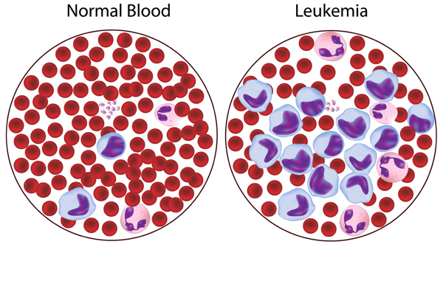
Leukemia
Leukemia is the cancer of the white blood cells
White blood cells help your body fight infection
Your blood cells form in you bone marrow
In leukemia, however the bone marrow produces abnormal white blood cells
These cells crowds out the healthy blood cells, making it hard for blood to do its work.

Slide 5
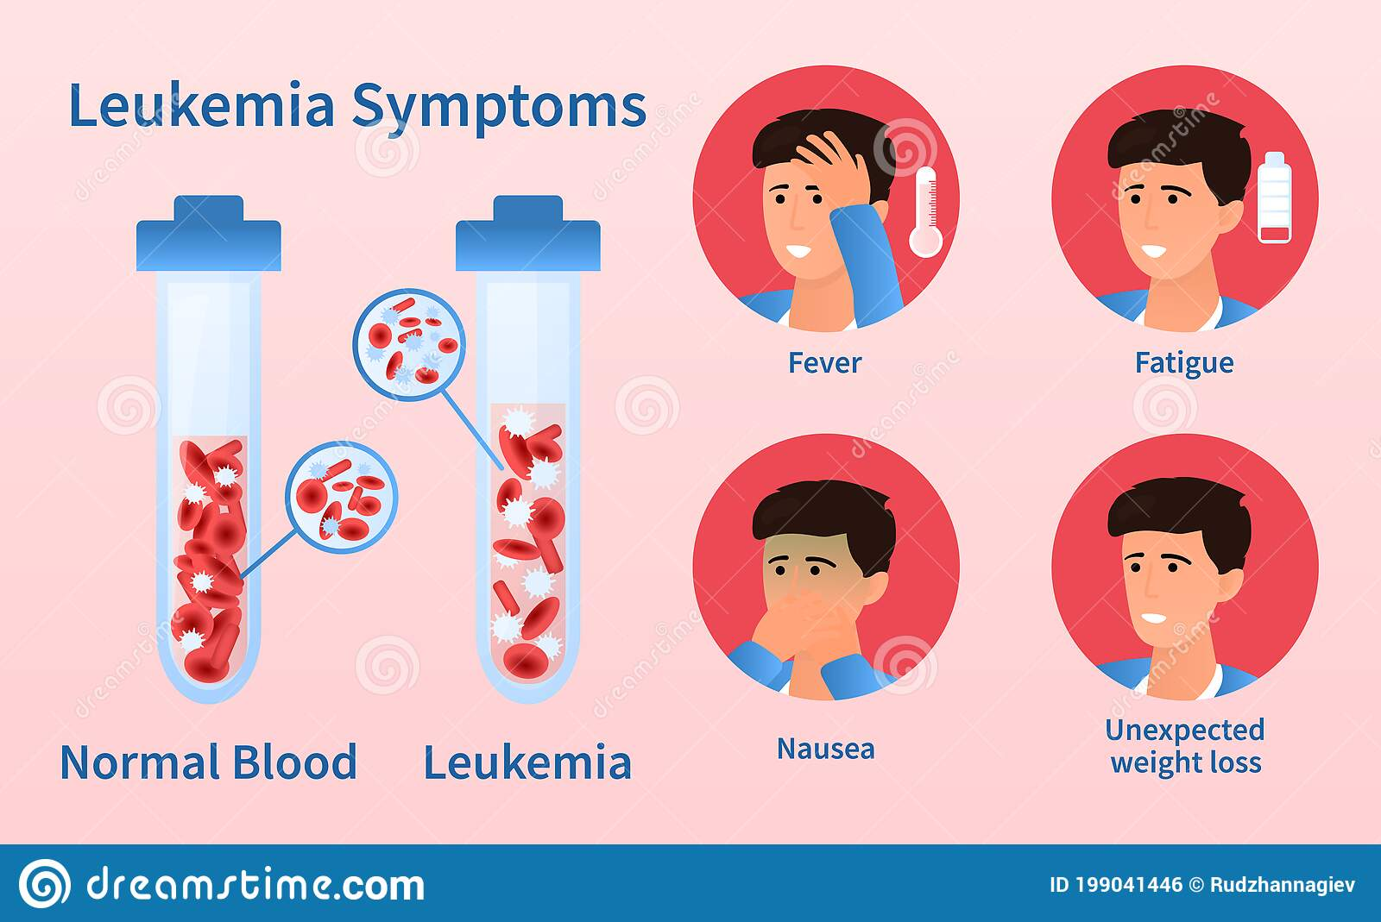
Leukemia Symptoms

Slide 6
What is ALL?
Acute lymphocytic leukemia is a type of acute leukemia. It's also called ALL and acute lymphoblastic leukemia.
"Acute" means that it usually gets worse quickly if it's not treated
ALL is the most common type of cancer in children. It can also affect adults.
In ALL, there are two many of specific types of white blood cells called lymphocytes of lymphoblasts.

Slide 7
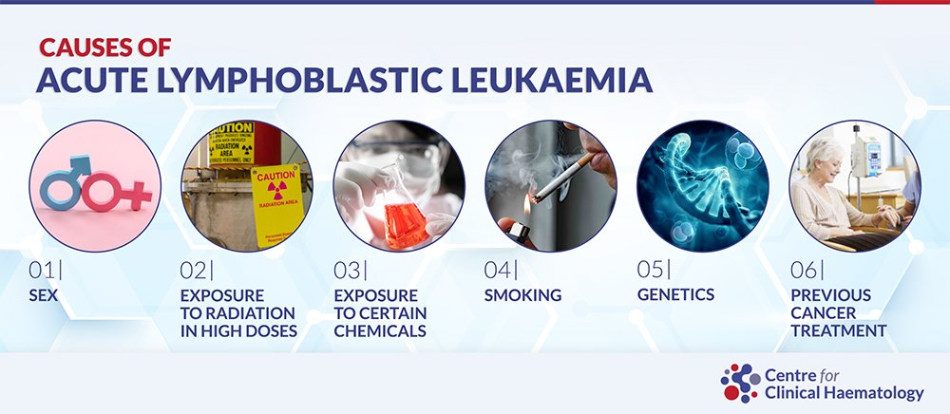
Causes of all

Slide 8
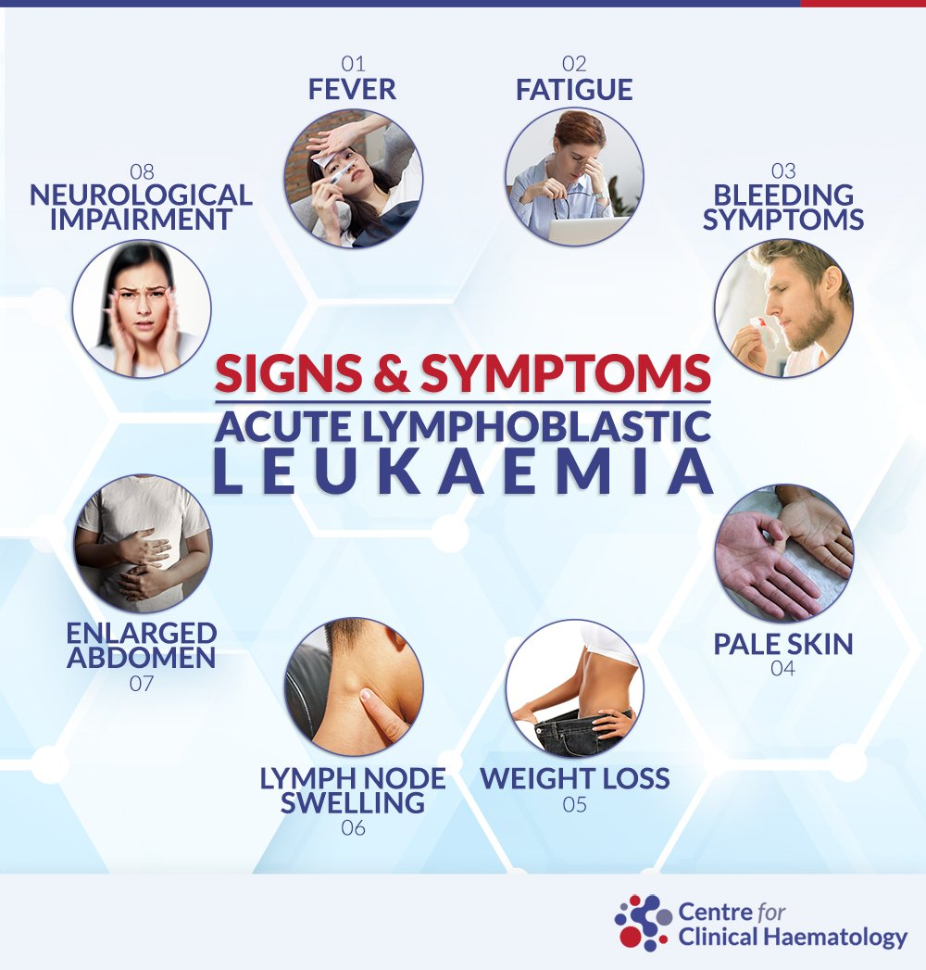
Symptoms of all include::::

Slide 9
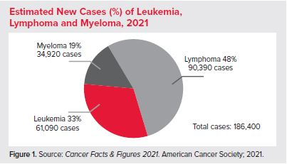
Project motives
Approximately every 3 minutes, one person in the US is diagnosed with leukemia, lymphoma or myeloma.
An estimated combined total of 186,400 people in the US are expected to be diagnosed with leukemia, lymphoma or myeloma in 2021.
New cases of leukemia, lymphoma and myeloma are expected to account for 9.8 percent of the estimated 1,898,160 new cancer cases that will be diagnosed in the US in 2021.
In Jordan, Annually 90 children are diagnosed with leukemia
Early and accurate diagnosis of the treatment provided makes the cure rate more than 90%

Slide 10
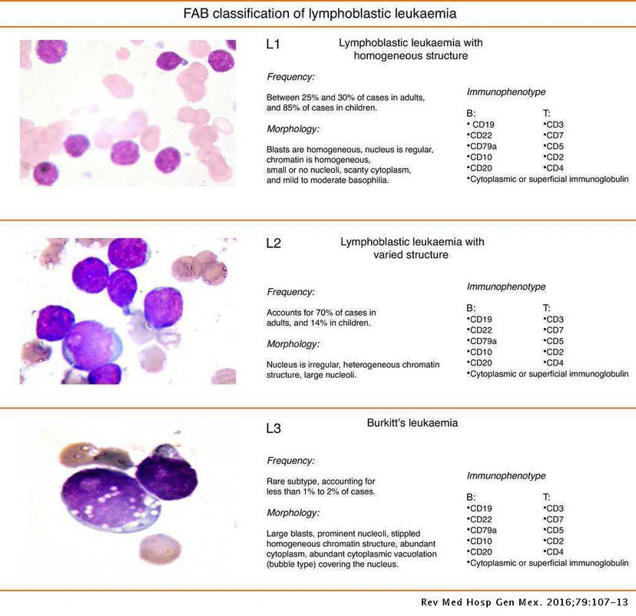
Classifications of ALL

Slide 11
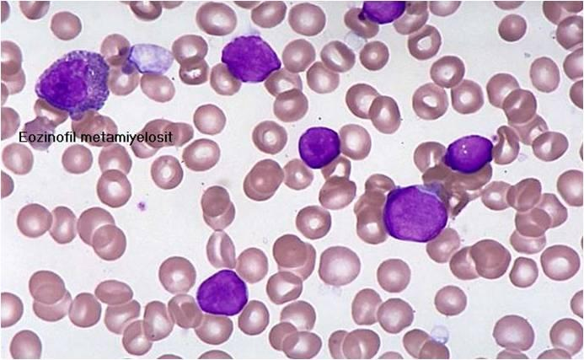
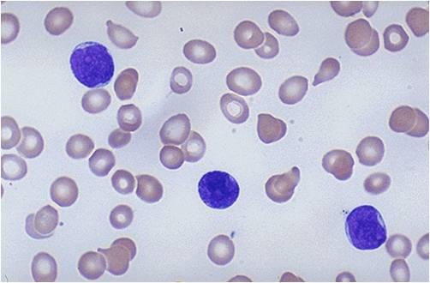
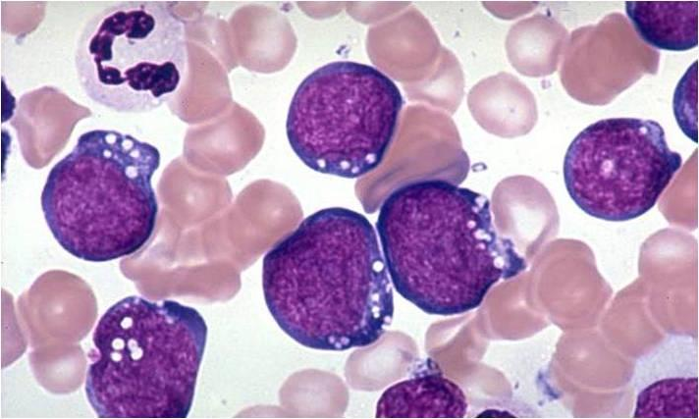
L1 L2 L3
Classifications of ALL

Slide 12
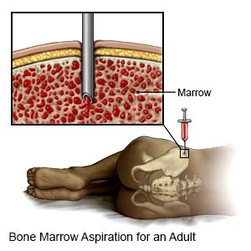
Bone marrow test

Slide 13
Problem statement
Acute leukemia is a life-threatening disease common in children and adults
ALL needs, invasive, costly, and time-consuming diagnostic procedures.
The manual diagnosing method is completely reliant on professionally trained medical specialists and their experience. And this makes the examination fraught with problems, such as diagnostic mistakes.
Many other factors contribute to misdiagnosis, such as poor peripheral blood smear (PBS) machine quality images or the non-specific nature of ALL signs and symptoms.
This project investigates the opportunity to explore the best machine learning techniques to improve the ALL diagnosis by analyzing the best features of the disease. And mainly to classify between the benign and the early stages.

Slide 14
Project goals
Analyze the medical data images related to ALL.
Detect the best features related to ALL PBS images.
Investigate the best approaches to extracting the selected features in (2).
Apply multiple machine learning and deep learning models over the extracted features to find the model with the highest accuracy for classifying the PBS images.
Compare the results with previous works and analyze the output.
Generate a recommendation report

Slide 15

Learning outcomes
1. Pre-processing the PBS image by applying some filters, such as Active Contour
2. Explore and detect the disease pattern features.
3. Implementing different deep learning models to classify PBS images, like ResNet152 or vgg16.
4. Test Convolutional Neural Network as feature extractor with different ML classifiers and compare the results.
5. Provide a recommendation report on the best classifier for ALL PBS images.

Slide 16
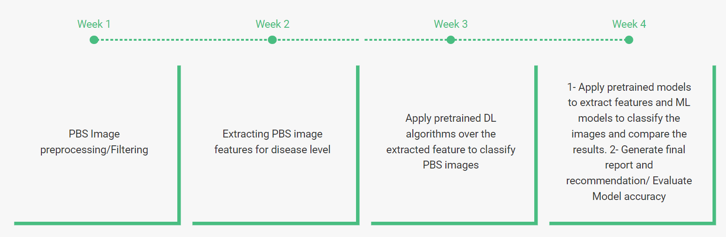
Project plan

Slide 17
Dataset
Kaggle
This dataset consisted of 3256 PBS images from 89 suspected of ALL patients whose blood samples were prepared and stained by skillful laboratory staff.
This dataset is divided into two classes benign and malignant(3 stages L1,L2 and L3).

Slide 18
thanks

